Slide 1




CIT 596 MODULE 14.2
Vertex Cover, Clique
Sampath Kannan

Slide 2



VERTEX COVER (VC)
Given a graph $G=\left(V,E\right)$, a vertex cover is a subset $S⊆V$, so that for each edge $\left(u,v\right)∈E$ at least one of $u \text{or} v$ lies in $S$.
Vertex cover decision problem (VC):
Instance: graph$G$, integer $k$
Question: does $G$ have a vertex cover of size at most $k$?
Clearly in NP. The certificate is just the subset of vertices forming the vertex cover. An algorithm can check in polynomial time that the subset is of the right size and that every edge is covered.

Slide 3




IS AND VC
Once again, we have a choice of which NP-complete problem to reduce to VC. This time independent set (IS) is the right one.
Before we do the reduction, let’s understand the relationship between IS and VC.
This means $V−S$is a vertex cover
Graph $G=(V,E)$
Independent Set $S$
All edges have at least one
endpoint outside $S$

Slide 4
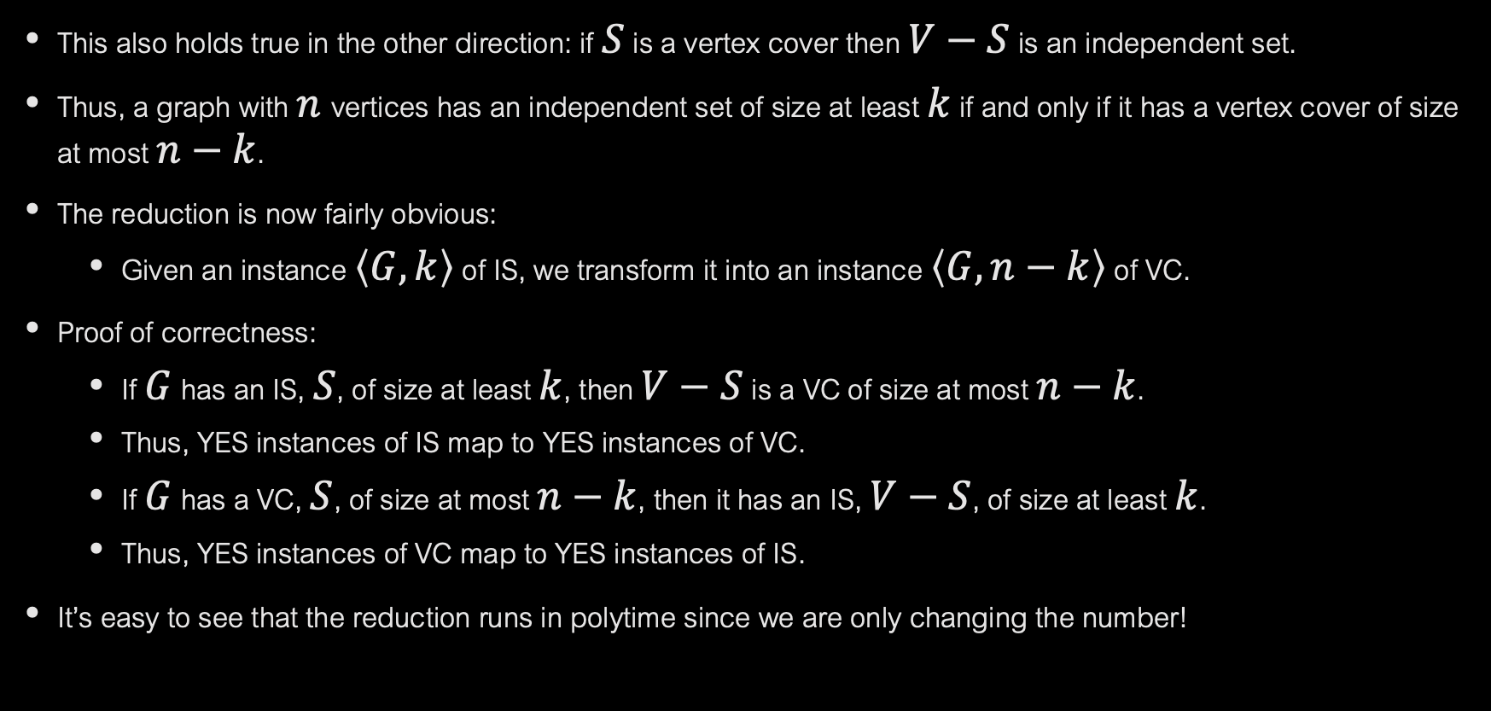
This also holds true in the other direction: if $S$ is a vertex cover then $V−S$ is an independent set.
Thus, a graph with $n$vertices has an independent set of size at least $k$ if and only if it has a vertex cover of size at most $n−k$.
The reduction is now fairly obvious:
Given an instance $\left\langle G,k\right\rangle$ of IS, we transform it into an instance $\left\langle G,n−k\right\rangle$ of VC.
Proof of correctness:
If $G$ has an IS, $S$, of size at least $k$, then $V−S$ is a VC of size at most $n−k$.
Thus, YES instances of IS map to YES instances of VC.
If $G$ has a VC, $S$, of size at most $n−k$, then it has an IS, $V−S$, of size at least $k$.
Thus, YES instances of VC map to YES instances of IS.
It’s easy to see that the reduction runs in polytime since we are only changing the number!

Slide 5
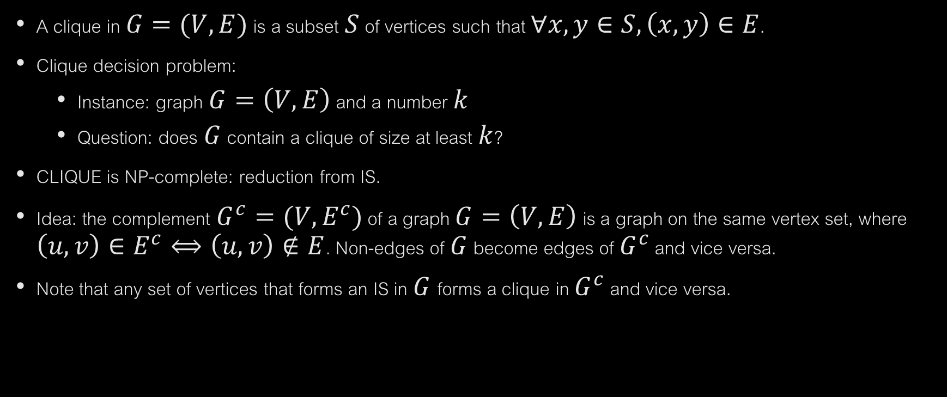
CLIQUES
A clique in $G=(V,E)$ is a subset $S$ of vertices such that $∀x,y∈S, \left(x,y\right)∈E$.
Clique decision problem:
Instance: graph $G=\left(V,E\right)$ and a number $k$
Question: does $G$ contain a clique of size at least $k$?
CLIQUE is NP-complete: reduction from IS.
Idea: the complement $G^{c}=(V,E^{c})$ of a graph $G=\left(V,E\right)$ is a graph on the same vertex set, where $\left(u,v\right)∈E^{c}⟺\left(u,v\right)∉E$. Non-edges of $G$ become edges of $G^{c}$ and vice versa.
Note that any set of vertices that forms an IS in $G$forms a clique in $G^{c}$ and vice versa.

Slide 6
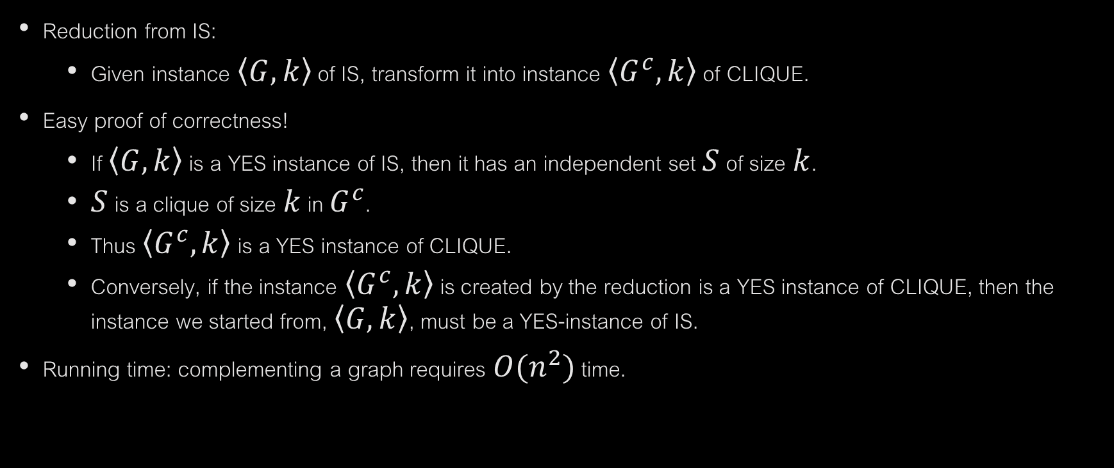
CLIQUE IS NP-COMPLETE
Reduction from IS:
Given instance $\left\langle G,k\right\rangle$ of IS, transform it into instance $\left\langle G^{c},k\right\rangle$ of CLIQUE.
Easy proof of correctness!
If $\left\langle G,k\right\rangle$ is a YES instance of IS, then it has an independent set $S$ of size $k$.
$S$ is a clique of size $k$ in $G^{c}$.
Thus $\left\langle G^{c},k\right\rangle$ is a YES instance of CLIQUE.
Conversely, if the instance $\left\langle G^{c},k\right\rangle$ is created by the reduction is a YES instance of CLIQUE, then the instance we started from, $\left\langle G,k\right\rangle$, must be a YES-instance of IS.
Running time: complementing a graph requires $O(n^{2})$ time.

